Slide 1
Employee Data Analysis using Excel
STUDENT NAME: VALLIYAMMAL.S
REGISTER NO: 312200486
DEPARTMENT: B. COM. COMPUTER APPLICATION
COLLEGE: S I.V.E.T COLLEGE

Slide 2
PROJECT TITLE
CREATING AN EMPLOYEE PERFORMANCE SCORECARD IN EXCEL

Slide 3


AGENDA
Problem Statement
Project Overview
End Users
Our Solution and Proposition
Dataset Description
Modelling Approach
Results and Discussion
Conclusion
3/21/2024 Annual Review

Slide 4

PROBLEM STATEMENT
*On the Data tab, in the Analysis group, click Solver. *In the Set Objective box, enter a cell reference or name for the objective cell. *In the Subject to the Constraints box, enter any constraints that you want to apply

Slide 5

PROJECT OVERVIEW
The project will be considered successful if it provides actionable insights that lead to measurable improvements in employee retention, performance , and overall satisfaction

Slide 6


WHO ARE THE END USERS?
*Employee
*Employer
* Management
*Industry
*Organization

Slide 7
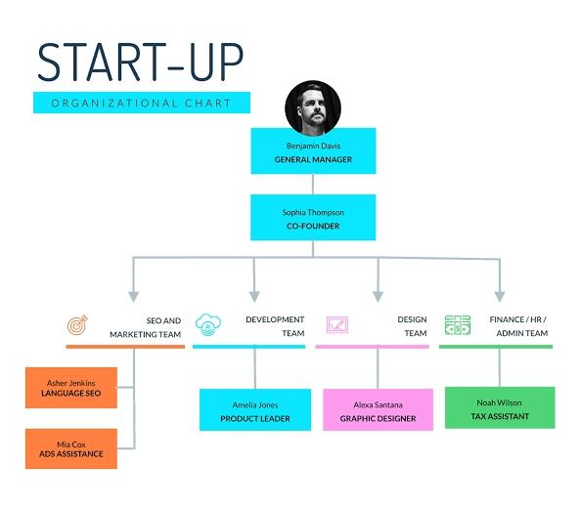

Slide 8

OUR SOLUTION AND ITS VALUE PROPOSITION
Conditional formatting – Missing
Formula –performance=IF(L2=5,”VERY HIGH”,IF(2=4,HIGH”,IF(L2=3,”MED”IF(2=2”LOW”,”))))
FILTER-RREMOVE:
Pivot table –summary
GRAPH DATA VISUALIZATION

Slide 9
Dataset Description
Employee kaggle
26-features
13-features
EMP IDM-NUM
First Name
Last Name
EMP type Performance level Gender-Male Female Title
Supervisor
Business unit Employee status Employee type Employee classification
Race DESC
Location Code Employee rating-NUM Performance level

Slide 10
THE "WOW" IN OUR SOLUTION
=IFD(X2=5,"VERYHIGH", IF (X2=4, "HIGH", I F(X2=3,"MED",IF(X2=2,"LOW",)
3/21/2024 Annual Review
10

Slide 11
MODELLING
Data collection :1.Edunet download 2.Goodwill download Feature : Identifying features one by one What features you will identify Data leaning:1.Missing values identify 2.Missing values filter out Performance level: Calculate which column you will performanceSummary:1.Pivot table2. graphs3.Ppt
11

Slide 12
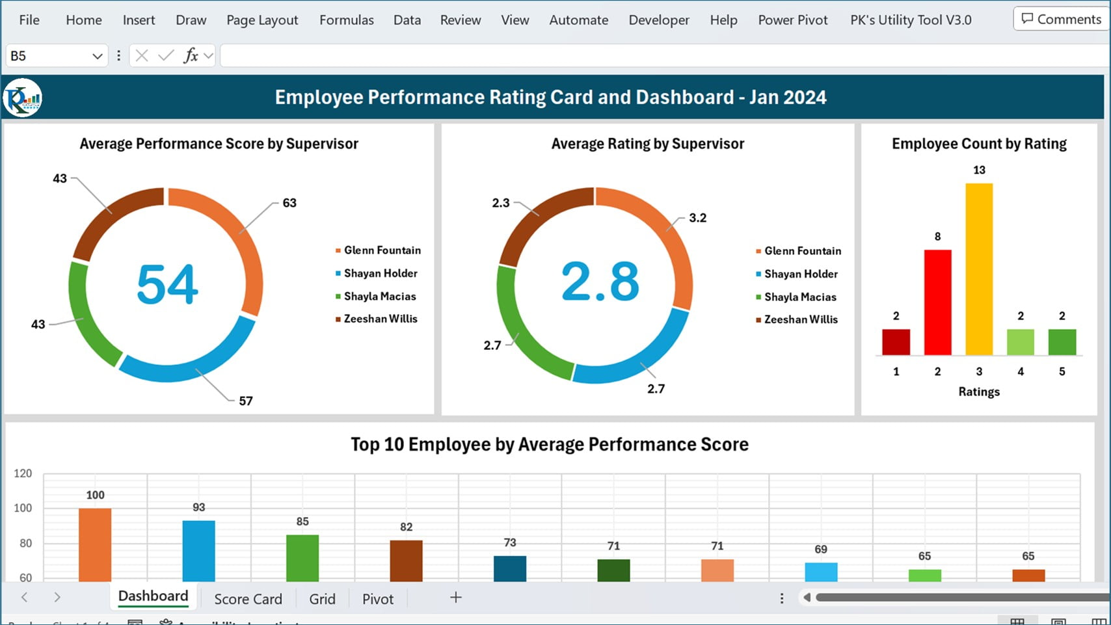
RESULTS
12

Slide 13
conclusion
1.Download the data employee from Edunnet Dashboard.
2.Filter the employee data
3.Created a performance level using formula.
4.In Insert option using pivot table create a table EMPLOYEE PERFORMANCE ANALYSIS.
5.Also create a pie chart graph.

